Slide 1
OS MEMORY ALLOCATION
By : Vidhya M (1NH17CS428)
Reviewed by
Ms. Asha Rani Borah
(Senior Assistant Professor, Dept. of CSE)

Slide 2
INTRODUCTION
This project describes work that most efficient way of assigning memory to process
Memory management is the process of an operating system
Memory management allocation consists of two techniques, namely:
single contiguous allocation
multiple contiguous allocations.
Memory management consist of allocating a partition to a job when it starts and un-allocating it when the job ends

Slide 3
ABSTRACT
To simulate different memory allocation algorithms in a program
There are many ways the process are assigned with the holes so it’s important to choose the most efficient way.
For this purpose a simulator is written for memory allocation techniques.
The different allocation techniques implemented are
First Fit
Best Fit
Worst Fit
Bext Fit

Slide 4
Advantages
Allocating memory is easy and cheap.
Any free page is ok; OS can be taken first one out of list it keeps.
Eliminates external fragmentation.
Data can be scattered all over physical memory.
Pages are mapped appropriately in anyway.
Allow s demand paging and prep-aging.
More efficient swapping.
No need for considerations about fragmentation.
Just swap out page least likely to be used.

Slide 5
REQUIREMENTS SPECIFICATIONS
Software Requirements Specification
Windows operating System version XP and above
Turbo C or C++ compiler 3.2 version and above
Hardware Requirements Specification
Processor : Pentium 4 and above
Ram : 512 MB(min)
Hard disk : 20 GB(min)
Clock speed of CPU : 1ghz(min)

Slide 6
Flow Chart
Get no. of Processes and no. of blocks. And size of each process and block
Start by picking each process and check if it can be assigned to current block.
If size-of-process <= size-of-block if yes then assign and check for next process.
Else leave that process and keep checking the further processes
find min (block Size [1], block Size [2] ,..... block Size [n]) > process Size [current] . If found then assign it to the current process.
Else leave that process and keep checking the further processes.
find max (block Size [1], block Size [2] ,..... block Size [n]) > process Size[current]
If found then assign it to the current process. Else leave that process and keep checking the further processes.
If size-of-process <= size-of-block [position] if yes then assigns the process and assign the value of position to next block and check for next process.
Else leave that process and keep checking the further processes
Display the processes with the blocks that are allocated to a respective process.

Slide 7
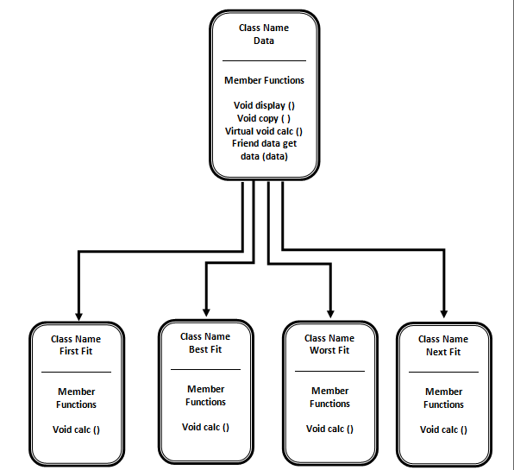
Class Diagram

Slide 8
OOPS concepts Used
Class
Objects
Data Abstraction and Encapsulation
Inheritance
Polymorphism
Friend Function
Virtual functions
Dynamic memory allocation
Dynamic Binding

Slide 9
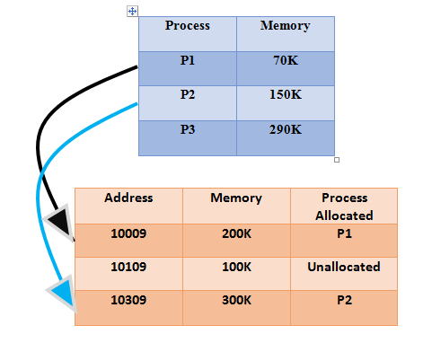
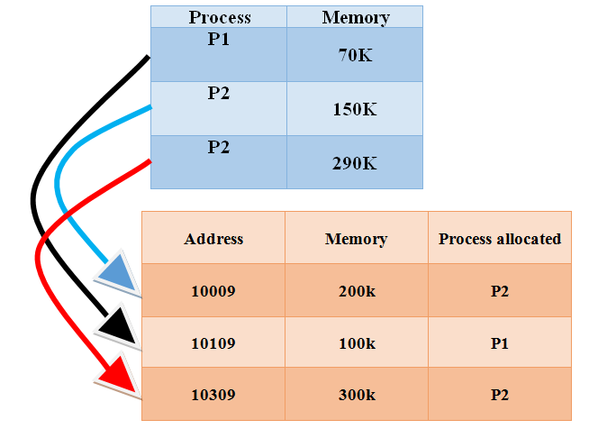
EXAMPLE
First Fit Best Fit

Slide 10
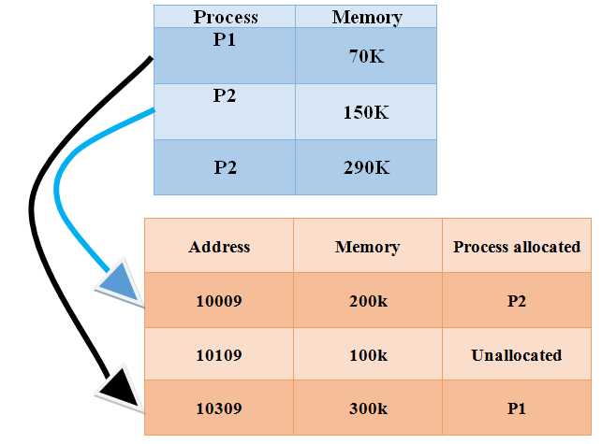
Worst Fit Next Fit

Slide 11
CONCLUSION
We have wrapped all memory allocation techniques in a single program this program
can be used to identify which memory allocation technique is more efficient for your program
We conclude that best fit is not always the best algorithm to be used in some cases worst fit and also first fit is more efficient than best fit
This project can be used to compare between all the memory allocation techniques and find the most efficient one.

Slide 12
THANK YOU…

